Slide 1
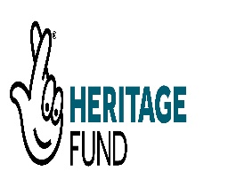
Image copyright of the University of Warwick
A collaborative digital preservation risk model
David Underdown, Alex Green and Hannah Merwood
5 August 2020

Slide 2
Why build a new digital preservation risk model?
What already exists?
1996: Paul Conway “Preservation in the Digital World”
2005: David Rosenthal et al “Requirements for Digital Preservation Systems: A Bottom-Up Approach”
2008-2015: Donnelly et al “DRAMBORA”
2012: Vermaaten et al “Identifying Threats to Successful Digital Preservation: the SPOT Model for Risk Assessment”
2020: Altman and Landau “Selecting efficient and reliable preservation strategies: modeling long-term information integrity using large-scale hierarchical discrete event simulation”
Notes:
Paul Conway seems to have been about the first to talk about digital preservation in terms of risks in his report almost 25 years ago for the Council on Library and Information Resources “Organizing for preservation in the digital world is not, first and foremost, a search for process efficiency, as has been the case with traditional preservation, but rather an ongoing process of risk management, where the cost of digital file migration is judged against the cost of failure to preserve the files in terms of the patrons who need the information. The stakeholders in this organization extend well beyond the bounds of a preservation department or the administration of a library or archives to encompass technology specialists, marketing experts, and commercial vendors.”
Since then various other general models proposed, including those on the slide. Rosenthal makes an important distinction between the models such as OAIS providing a top down way of looking at the functions, and risk models being a bottom up approach, explicitly declaring the threats from which we are trying to protect digital materials – and also those we are not considering.
DRAMBORA a very comprehensive model, and the SPOT model again refocused on looking at more specific threats and how they related to the aspects of digital objects that we need to maintain in order to preserve them – the paper also gives a good overview of the other models here, as well as some more specialised ones that cover only a particular area of risk, such as from IDCC this year Altman and Landau

Slide 3
What’s missing?
A general quantitative model
The general models are qualitative
The quantitative models cover only certain risks
Hard to compare different types of risk against each other
With limited resources, which risks should we mitigate first?
How do we demonstrate value for money to stakeholders?
Conversely, how do we make effective business cases?
Lots of accepted good practice
OAIS
NDSA Levels of Preservation etc
But is it truly rooted in reality?
Notes:
If our standards cannot be evidenced and shown to be effective, it’s possible that the policies we follow as a result of adhering to them could actually be counterproductive.

Slide 4
Enter Bayes
Revd Thomas Bayes (c1701-1761), non-conformist minister and mathematician
He solved a particular case of a more general problem in probability, given a bag containing a mixture of black and white balls, what can you say about the likely ratio of black and white balls, given a known sample of ball pulled from the bag?
The general field now takes his name
Bayesian models give rigorous methods for dealing with uncertain and changing knowledge about a system, and for incorporating expert judgement where hard statistical data is not available
Notes:
Our Digital Director, John Sheridan, was originally a mathematician and computer scientist, and come across enough about Bayesian models to feel that they offered a potential way forward. Used in various fields such as financial institutions assessing their ability to meet capital adequacy requirements, medical diagnosis, inspection regimes for railway bridges. Initially investigated by our Head of Service Assurance, Dr Alec Mulinder, but he was originally a medievalist, and eventually someone remembered that I was also originally a mathematician.

Slide 5
Initial research model
Notes:
Using Fenton and Neil’s book Risk Assessment and Decision Analysis with Bayesian Networks (now in second edition) and the accompanying AgenaRisk software we were able to develop some initial Bayesian Networks to validate the basic utility and applicability of the methods.
Book also gave an introduction to the expert elicitation methods, but we could see that we would really need some support from experienced practitioners.
Ironically the free version of AgenaRisk that accompanied the first edition was withdrawn, highlighting the digital preservation risks of proprietary software.

Slide 6
Building collaborative partnerships
Alan Turing Institute
the UK’s national institute for data science and artificial intelligence
“collaborate[s] with universities, businesses and public and third sector organisations to apply this research to real-world problems, with lasting effects for science, the economy, and the world we live in”
University of Warwick, Applied Statistics & Risk Unit
“has a remit to encourage and co-ordinate external partnerships which enable the early applications of theoretical, methodological and algorithmic developments.”
Archives
In addition to being the archive of the UK government, The National Archives has a formal remit to provide leadership and direction for the wider archives sector in the UK
Notes:
The National Archives holds the status of an Independent Research Organisation, can apply to research councils directly, our research department also builds links with academic institutions, including Alan Turing Institute.
Among the Turing Fellows, distinguished scholars from various academic institutions in the UK, was Prof Jim Q Smith
He was also on the staff of the University of Warwick’s Applied Statistics & Risk Unit, so through him, established a relationship with the unit and its director, Dr Martine Barons.
Further development work AS&RU, further validated concept, and applicability of methods.
Could have gone forward as a partnership with just these two, but felt that would lead to a model that might not be so widely applicable, being rather dependent on our own view of the digital preservation world.
Mindful of our sector remit, wanted to get wider involvement in the building of the model, and a more varied pool of expertise for the expert elicitation process.
Very much applied research at this stage, so limited prospect of receiving research council funding, though AS&RU were able to access an EPSRC Impact Acceleration Account to hire a post-doctoral research assistant to work on the project. We also hired a research assistant at The National Archives, my co-author, Hannah Merwood, who joined us on secondment from the Department of Digital, Culture, Media and Sport.

Slide 7
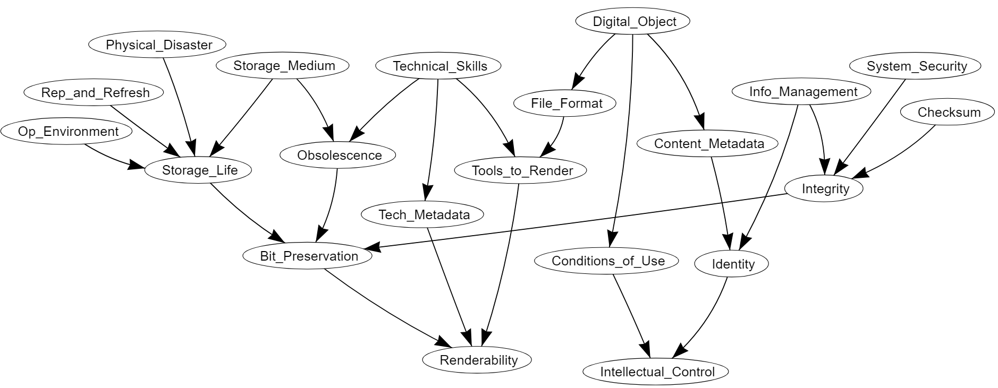
Digital Preservation Bayesian Network
Renderability: The object is a sufficiently useful representation of the original file.
Intellectual control: Having full knowledge of the material content, provenance and conditions of use.
Digital preservation outcomes
Copyright of the University of Warwick
Notes:
This is our Bayesian network of digital preservation risks. Each ‘node’ represents an underlying threat or important variable in calculating the overall risk. The precise definitions are all contained within the application.
Ultimate aim is for renderability and full intellectual control. All other factors can affect these. Sometimes they impact both, sometimes only one.
As an example, lets look at the node called ‘Obsolescence’, highlighted now in yellow on the middle left hand side of the network. The definitions is as follows:
Essential equipment, hardware or software required to access the bit stream becoming out of date or unusable. For example, hardware no longer being produced or essential software to access the media no longer supported.
This depends a lot on the storage medium used. For instance, D-1, an early Digital Video format, is far more at risk of obsolescence than an LTO tape. But if you have good technical skills you may be able to recover the bit-stream. This is why ‘storage_medium’ and ‘technical_skills’ are its parents. An object can only be bit-preserved if you do have access to the bit-stream, therefore this feeds into the probability of bit-preservation, which then feeds into the probability of renderability.
A large model can be treated as a collection of smaller local subsystems.

Slide 8
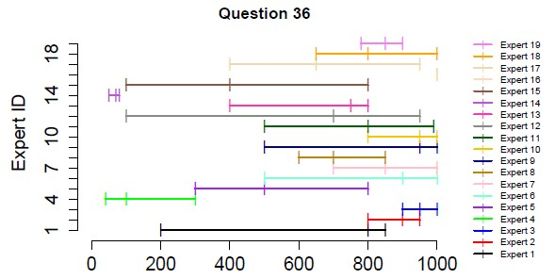
What is expert elicitation?
Investigate
Discuss
Estimate
Aggregate
Range graph from round 1 of the elicitation exercise
Copyright of the University of Warwick
Notes:
“Expert elicitation refers to a systematic approach to synthesize subjective judgments of experts on a subject where there is uncertainty due to insufficient data, when such data is unattainable because of physical constraints or lack of resources. “ From http://www.nusap.net/downloads/reports/Expert_Elicitation.pdf
We followed the IDEA protocol with a trained facilitor. Process is designed to reduce bias and group think.
22 experts from 10 different organisations.
Investigate: Background information sent in advance. Full discussion of each question to get a common understanding of how it should be interpreted and answered. All experts then answer this individually.
Discuss: Follow on discussion of anonymised visualisation of responses. Sometimes everyone agreed, sometimes there was a big variation. Discussion on why some people may have answered high, some low. Aim is not to achieve a concensus, just open dicusssion of ideas.
Estimate: All participants make second and final estimate. This is the one that will be used.
Aggregate: Final probability for the model is a combination of all their estimates, weighted by their performance on the calibration questions. Calibration questions are used to determine individual accuracy and informativeness and were embedded amongst the questions we needed answers to so experts answered them all in the same way.

Slide 9
DiAGRAM:The Digital Archiving Graphical Risk Assessment Model
https://nationalarchives.shinyapps.io/DiAGRAM-dev/
Puts all this into practice, answer nine questions about your own archive, then investigate your risk levels, see how different actions will change your risk levels
https://www.nationalarchives.gov.uk/information-management/manage-information/preserving-digital-records/research-collaboration/safeguarding-the-nations-digital-memory/

